Slide 1

Source Control with Git & GitHub
CSE 4th Semester: Practical Lab Guide
Tirupati Sahu | Department of CSE

Slide 2


What is Version Control?
The Problem
The Solution (Git)
Without version control, we rely on file renaming like "final_v1.py", "final_v2_fixed.py". This leads to confusion, data loss, and inability to collaborate effectively.
Git tracks every change made to files. It allows us to revert to previous versions, work on new features without breaking the main code, and collaborate with teams.

Slide 3

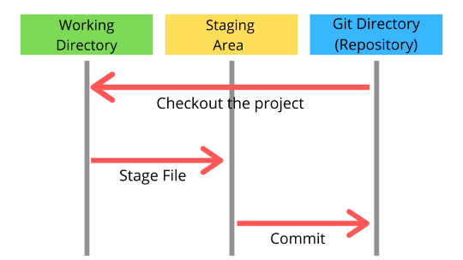
Git Architecture: The 3 Stages
Working Directory: Where you edit files.
•
Staging Area: Where you prepare files for the next commit (like a shopping cart).
•
•
Repository: Where Git permanently stores the changes (the receipt).

Slide 4

Practical Use Case
We will build a simple "Student Calculator" application to demonstrate the Git workflow.

Slide 5






Lab Step 1: Configuration
Verify Install
Set Username
Set Email
git --version
git config --global user.name "Your Name"
git config --global user.email "you@example.com"
Check if Git is installed.
Identifies your commits.
Links to your GitHub.

Slide 6
Lab Step 2: Init & Add
1. Initialize Repository
Explanation
mkdir Calculator
cd Calculator
git init
git init: Turns the current folder into a Git repository.
2. Create & Stage File
git add: Moves the file from the "Working Directory" to the "Staging Area". It is now ready to be saved.
# Create calculator.py
git add calculator.py

Slide 7
Lab Step 3: Committing
Command
Explanation
git commit -m "Initial commit: Basic calculator"
git commit: Takes a snapshot of the Staging Area and saves it to the Repository.
Checking Status
-m "message": Always include a clear message explaining what changed. This creates the project history.
git status git log

Slide 8

Lab Step 4: GitHub Integration
Why GitHub?
GitHub is a hosting service for Git repositories. It acts as a "Remote" backup and a collaboration hub.
Action
Create a new repository on GitHub.com named "Student-Calculator". Do not initialize with README.

Slide 9
Lab Step 5: Connecting Remote
Link and Push
git remote add origin https://github.com/username/Student-Calculator.git
git branch -M main
git push -u origin main
Explanation
•
remote add origin: Tells your local Git where the GitHub server is.
push: Uploads your local commits to the GitHub server.
•

Slide 10
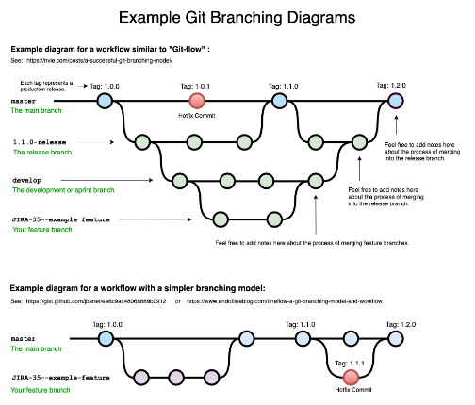
Lab Step 6: Branching
Concept
Branches allow you to work on new features (e.g., adding a "Multiply" function) without affecting the main working code.
Command
git branch feature-multiply git checkout feature-multiply

Slide 11
Lab Step 7: Merging
Concept
Once the feature is complete and tested, we merge it back into the main branch.
Command
git checkout main git merge feature-multiply

Slide 12


Lab Cheatsheet
Setup
Changes
Sync
Branching
git init
git status
git push
git branch
git clone [url]
git add [file]
git pull
git checkout
git config
git commit -m "msg"
git fetch
git merge

Slide 13
Questions?
Practical Demonstration Next

